Slide 1
Hook, Line and Sinker
A fish hook is used for one simple purpose. To catch a fish! But, the fisherman knows that if he wants to catch a yummy fish, he needs to put a big, fat juicy worm on the end of it. Fish typically won’t bite for a dead leaf or a sea shell.
Authors do the same thing. They load their ‘hook’ up with a yummy worm. They make their writing interesting for the reader. They use MANY different strategies to do this, but one way is in how they write the first sentence of their text.

Slide 2
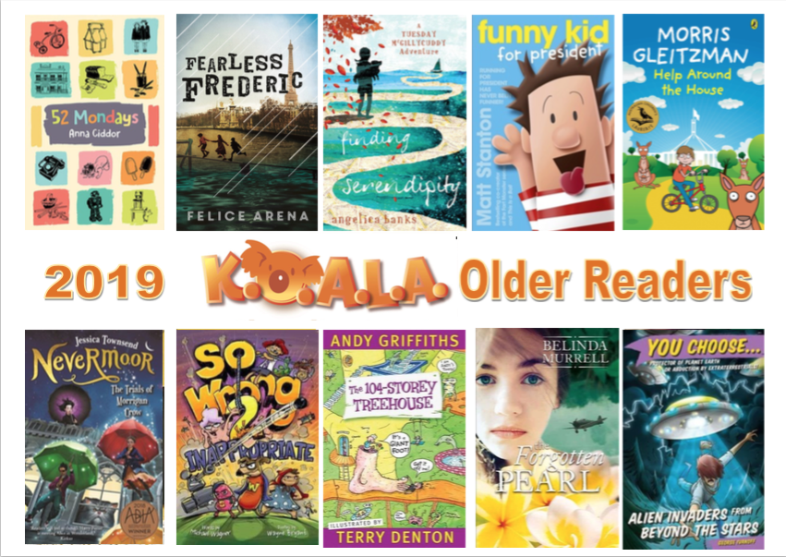
KOALA Shortlists

Slide 3
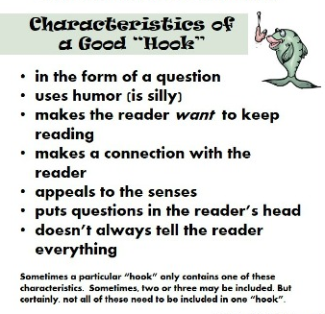
Lure the reader

Slide 4
First Lines | Which strategy has the author used? It could be more than one.
The boy lets loose with a high kick.
Someone has pooped in the classroom.
I’d never been on a plane before and I wasn’t exactly sure of the rules.
The world glowed with the fierce, dry heat of summer.
The kitchen cat was dead, and Morrigan was to blame.
Yep, you guessed it, Warren the One-legged Wonder Dog only has one leg.
India Wimple could spell. Brilliantly.
Poppy was sprawled along a branch of the old mango tree, her back against the gnarled grey trunk, reading a book.
You watch the light blaze across the night sky, a whooshing sound in its wake.
"Good-bye, school shoes," said Tuesday McGillycuddy, dropping her battered black lace-ups into a bin full of lunch wraps and orange peel.

Slide 5
Turn and Talk
Which line has lured you to read that book?
Turn to a partner and explain your choice
Class voting

Slide 6
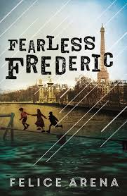
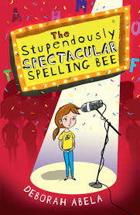
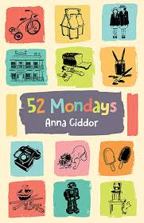
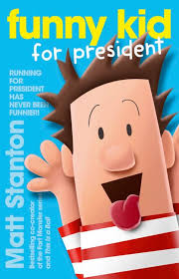
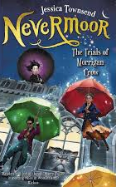
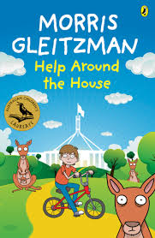
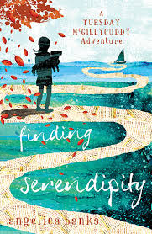
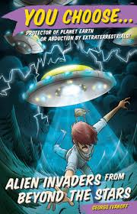
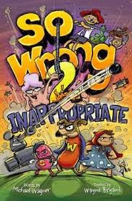
The world glowed with the fierce,
dry heat of summer.
Someone has pooped in the classroom.
The boy lets loose with a high kick.
India Wimple could spell. Brilliantly.
The kitchen cat was dead,
and Morrigan was to blame.
Poppy was sprawled along a branch of the old mango tree, her back against the gnarled grey trunk, reading a book.
Yep, you guessed it, Warren the One-legged Wonder Dog only has one leg.
I’d never been on a plane before
and I wasn’t exactly sure of the rules.
"Good-bye, school shoes," said Tuesday McGillycuddy, dropping her battered black lace-ups into a bin full of lunch wraps and orange peel.
You watch the light blaze across the night sky,
a whooshing sound in its wake.

