Slide 1
It’s Time to Nominate!
Nominations must be made by the end of Term 1 Week 10

Slide 3
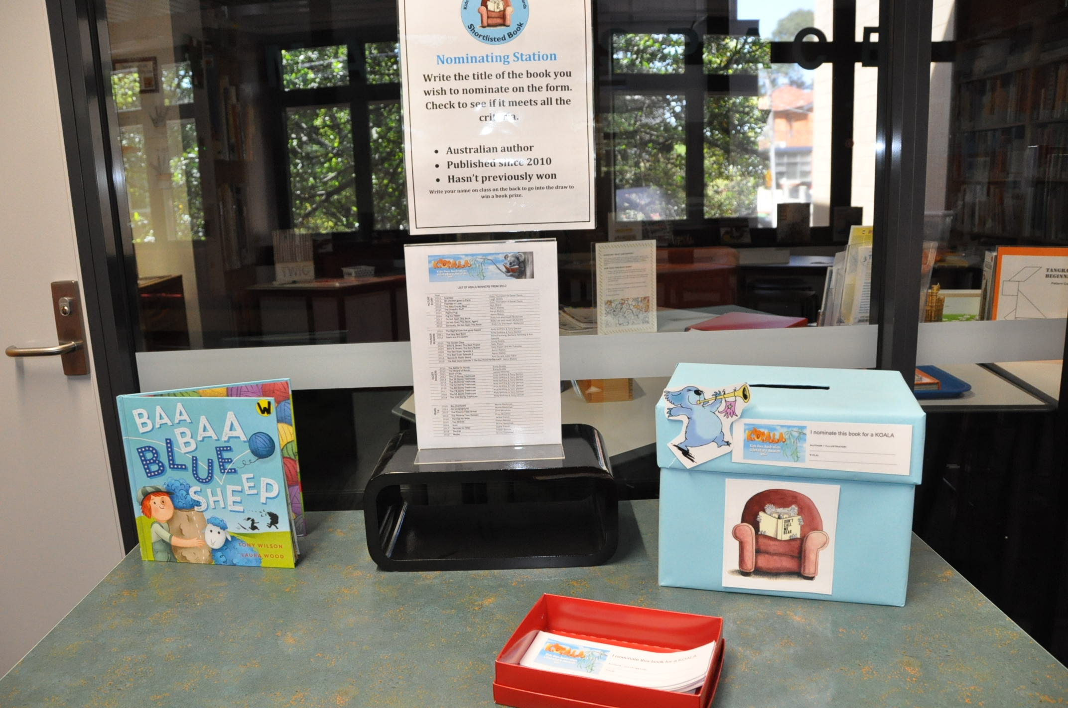

Slide 4
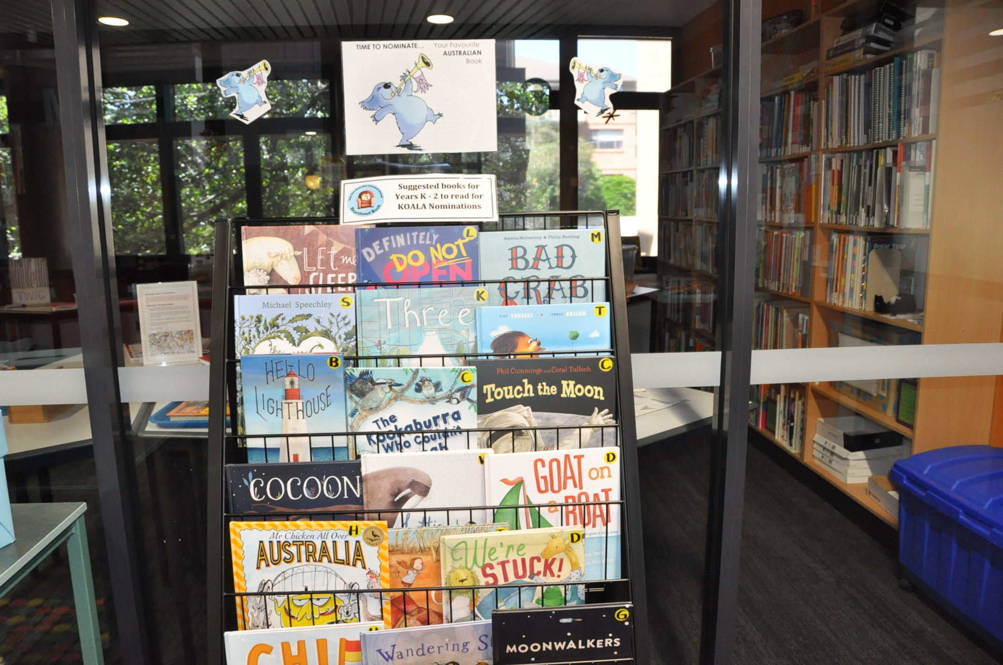

Slide 5
Nomination Criteria
The book must be Australian.
The book must have been published since 2011.
The book must not be a previous winner (Check previous winners list).
Nominations must be for a specific title e.g. Selby Surfs not Selby books.

Slide 6
How to Nominate
Fill in a nomination slip. Make sure that the book you nominate meets the four criteria for nomination.

